Slide 1

Hands-On Ethical Hacking and Network Defense,
Edition 4
Module 14: Hands-On Ethical Hacking Final Project
Simpson, Antill, Wilson, Hands-On Ethical Hacking and Network Defense, 4th Edition. © 2023 Cengage. All Rights Reserved. May not be scanned, copied or duplicated, or posted to a publicly accessible website, in whole or in part.

Slide 2
Module Objectives
By the end of this module, you should be able to:
  Set up a penetration testing lab of virtual machines for use in penetration testing activities and practice
  Perform penetration testing and vulnerability analysis using tools previously discussed in this course
  Create a penetration testing report document to capture and communicate information regarding the vulnerabilities discovered during your penetration testing

Slide 3
Setting Up the Penetration Testing Lab
The penetration testing lab
  Will consist of a number of virtual machines (VMs) running inside of Oracle VirtualBox
  You will connect the new VMs using a host-only adapter network in VirtualBox
    Will ensure that the testing environment is isolated from other devices on any real network you are connected to
You will use the following VMs:
  Axigen mail server
  Kali Linux 2021 Oracle Virtual Appliance (O V A)
  Metasploitable2 O V A
The computer you use to host the lab environment needs at least 8 GB of memory

Slide 4
Configuring VirtualBox (1 of 3)
If you no longer have VirtualBox and Axigen installed:
  Return to Activity 2-2 and follow the instructions
If you have Microsoft Hyper-V virtualization running on your computer:
  You must disable the Hyper-V service in order for VirtualBox to work

Slide 5
Configuring VirtualBox (2 of 3)
VirtualBox
  Will host the collection of lab VMs that will serve as targets for your penetration testing
  Provides the networking option that allows your VMs to communicate with all devices on your network
In this module, don’t scan everything on the network
  May lead to confusing results or to accessing devices you don’t have permission to scan

Slide 6
Configuring VirtualBox (3 of 3)
For each VM in VirtualBox that is part of the lab environment, you must change the network settings and connect the VM to the host-only adapter network
  To change the network setting of a VM:
    In the right pane of VirtualBox, right-click the VM
    Click Settings on the shortcut menu
    In the left pane of the Settings window, click Network
    In the Network form, click the Attached to button, and then click Host-only Adapter
    Click the Name button
      Then click the name of your host-only adapter network, such as VirtualBox Host-Only Ethernet Adapter

Slide 7
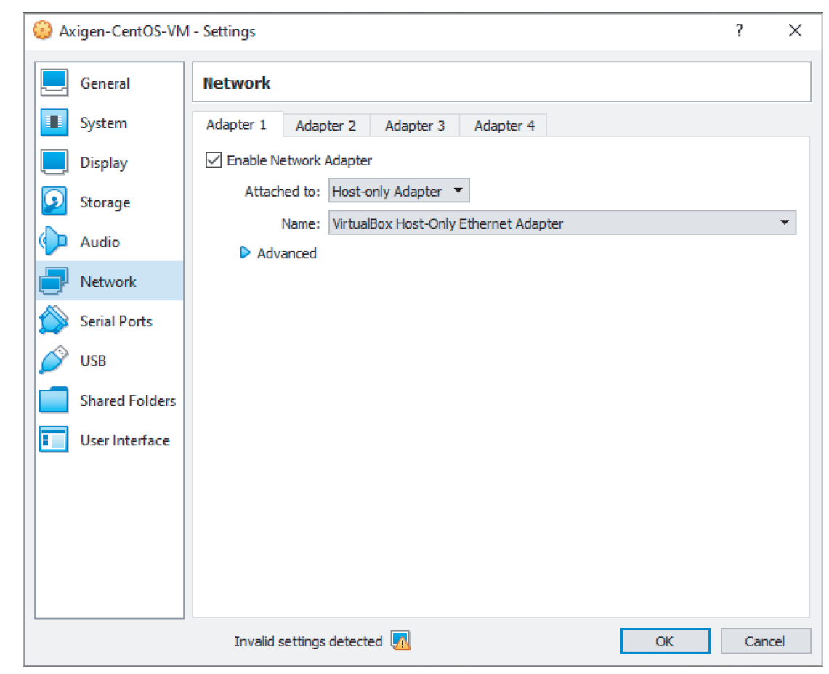
Configuring Axigen
You installed the Axigen Mail Server in Activity 2-2
  Return to Activity 2-2 if you no longer have it installed
  Change the Axigen network settings so that it connects to the host-only adapter network
Source: Oracle VirtualBox

Slide 8
Installing and Configuring Kali Linux 2021 O V A (1 of 5)
The Kali Linux instance must be contained in VirtualBox
  If you already have Kali Linux installed in VirtualBox, you can use your existing VM as long as you change its network settings
    To connect it to the Host-only Adapter network
O V A stands for Oracle Virtual Appliance
  Virtual appliance
    A virtual machine that has already been installed on virtual hardware
  Importing an O V A is more convenient than building a virtual machine from scratch

Slide 9
Installing and Configuring Kali Linux 2021 O V A (2 of 5)
To install the Kali Linux O V A:
  Use a browser to go to Kali Virtual Machines website
    Download the O V A file
    Choose the VirtualBox 64-bit version
  In VirtualBox, click File on the menu bar, and then click Import Appliance

Slide 10
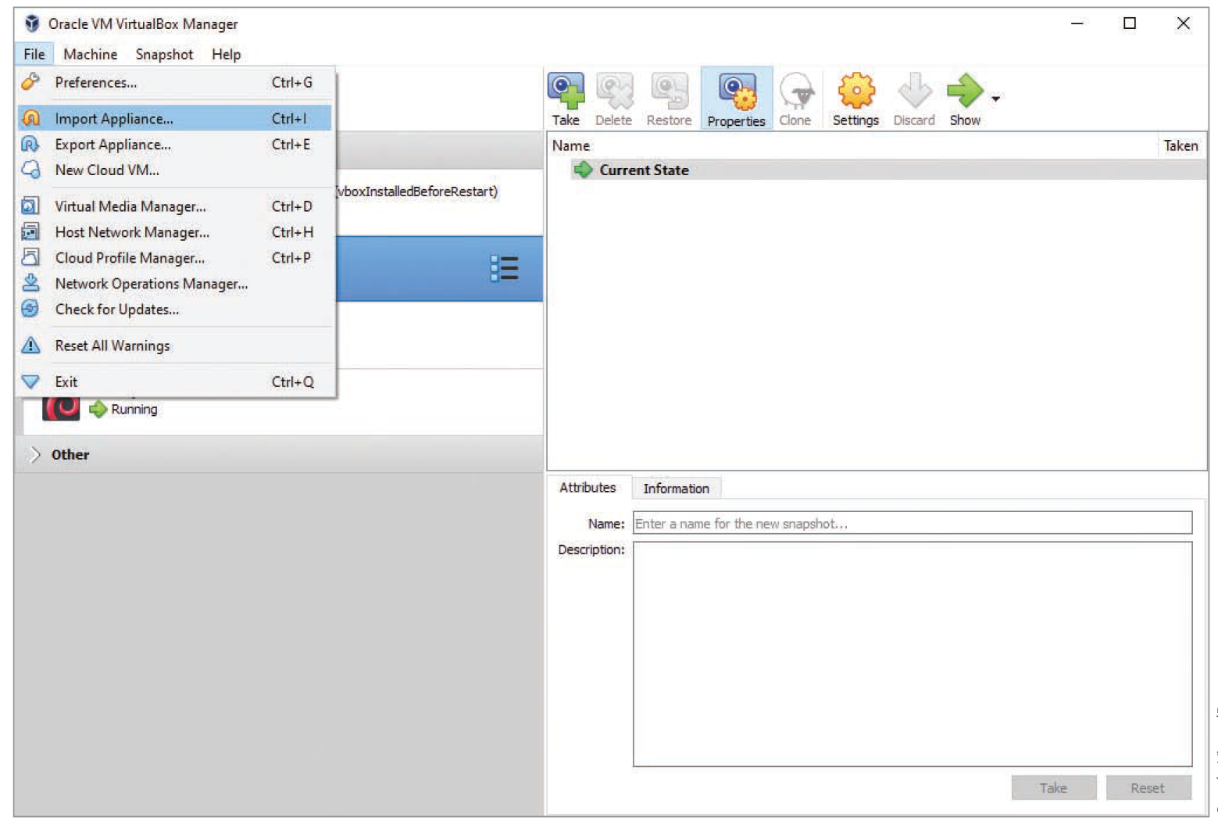
Installing and Configuring Kali Linux 2021 O V A (3 of 5)
Oracle VirtualBox
Figure 14-3 Importing a virtual appliance

Slide 11
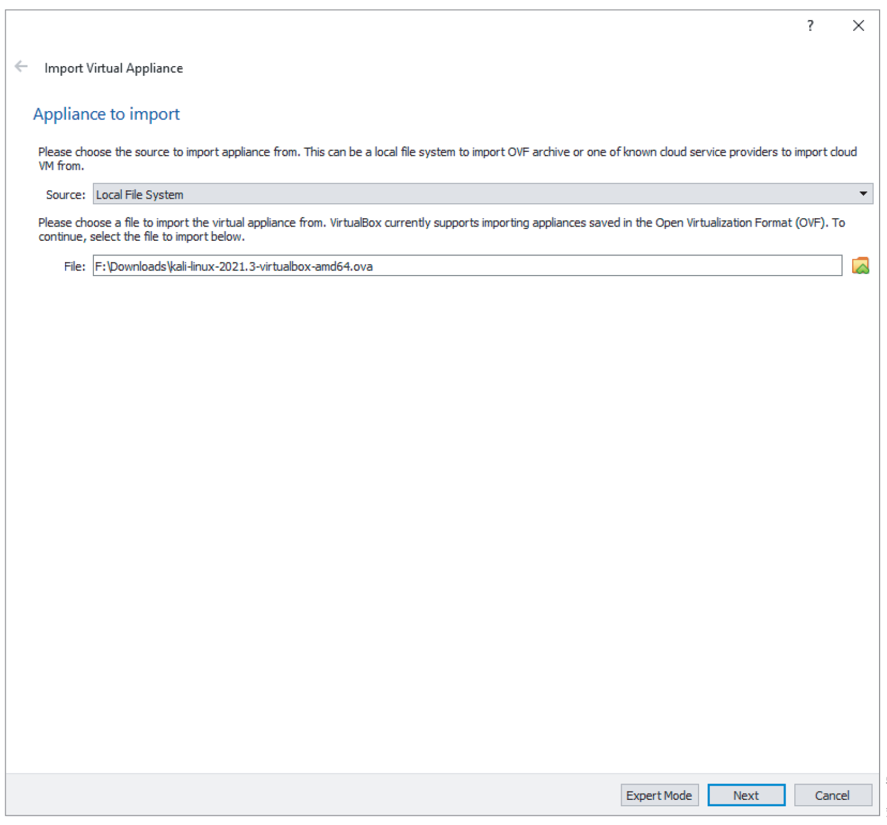
Installing and Configuring Kali Linux 2021 O V A (4 of 5)
Oracle VirtualBox
Figure 14-4 Import Virtual Appliance file selection

Slide 12
Installing and Configuring Kali Linux 2021 O V A (5 of 5)
To install the Kali Linux O V A (continued):
  With the O V A file selected, click Next
  Review the Appliance Settings and then click Import to begin the import
  When a Software License Agreement window opens, click Agree to continue
  After the import is complete, right-click the Kali VM
    Click Settings on the shortcut menu
    Change the Network Settings so that the Kali VM is on the same network as the other VMs

Slide 13
Installing and Configuring Metasploitable2 (1 of 11)
Metasploitable2
  Has been purposefully constructed to be vulnerable to attack
  Designed to provide pen-testers with a target containing security flaws that can be used to practice pen-testing
Downloading Metasploitable2, provided by Rapid7, will be shown using figures in the next few slides

Slide 14
Installing and Configuring Metasploitable2 (2 of 11)
To create the Metasploitable2 VirtualBox VM:
  Use a browser to go to Metasploitable Virtual Machine Test website
  Click the DOWNLOAD METASPLOITABLE NOW button to download Metasploitable2
  If the download doesn’t start, right-click the button, copy the link address, open a new tab in your browser, and then paste the address in the address bar
  You may be requested to fill in a form and provide information such as your email address

Slide 15
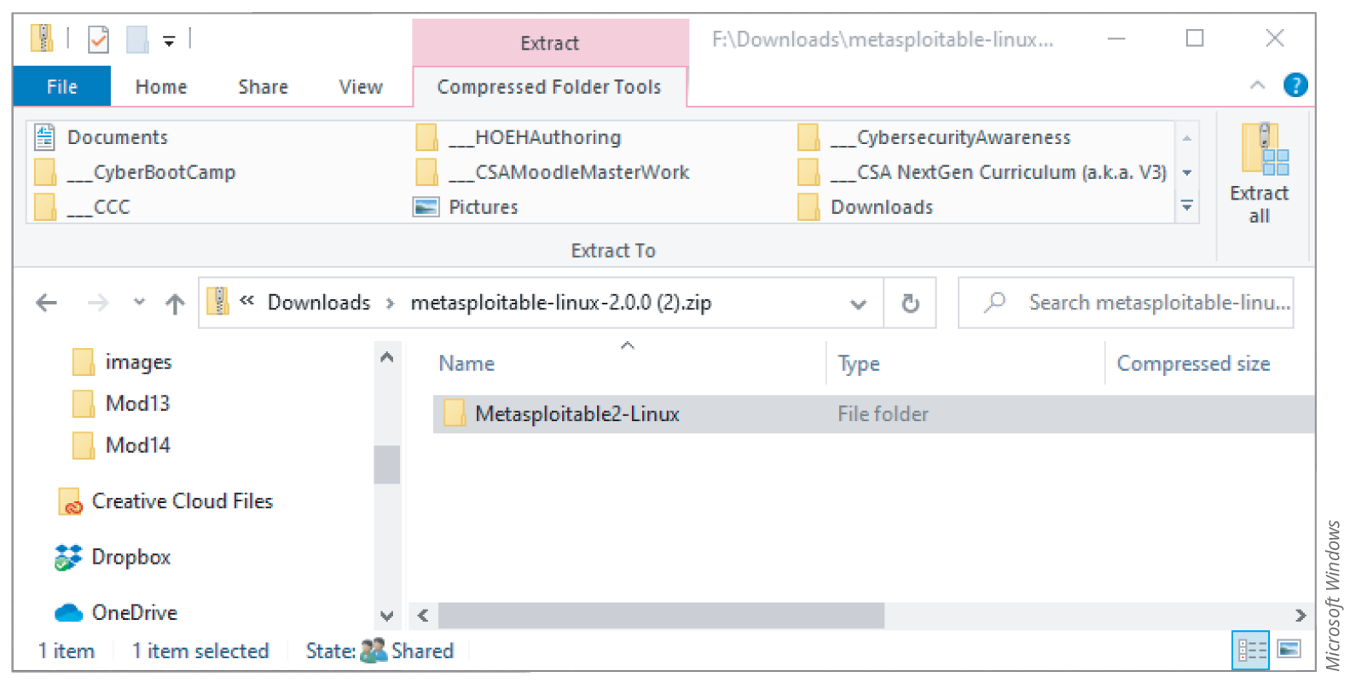
Installing and Configuring Metasploitable2 (3 of 11)
Use the Extract All command to extract the installation files from the compressed file you downloaded

Slide 16
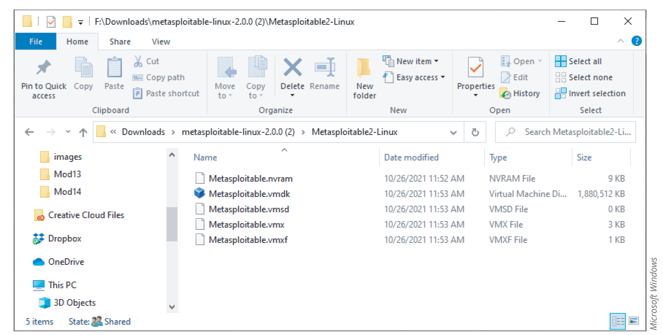
Installing and Configuring Metasploitable2 (4 of 11)
Microsoft Windows
Figure 14-6 Metasploitable extracted files

Slide 17
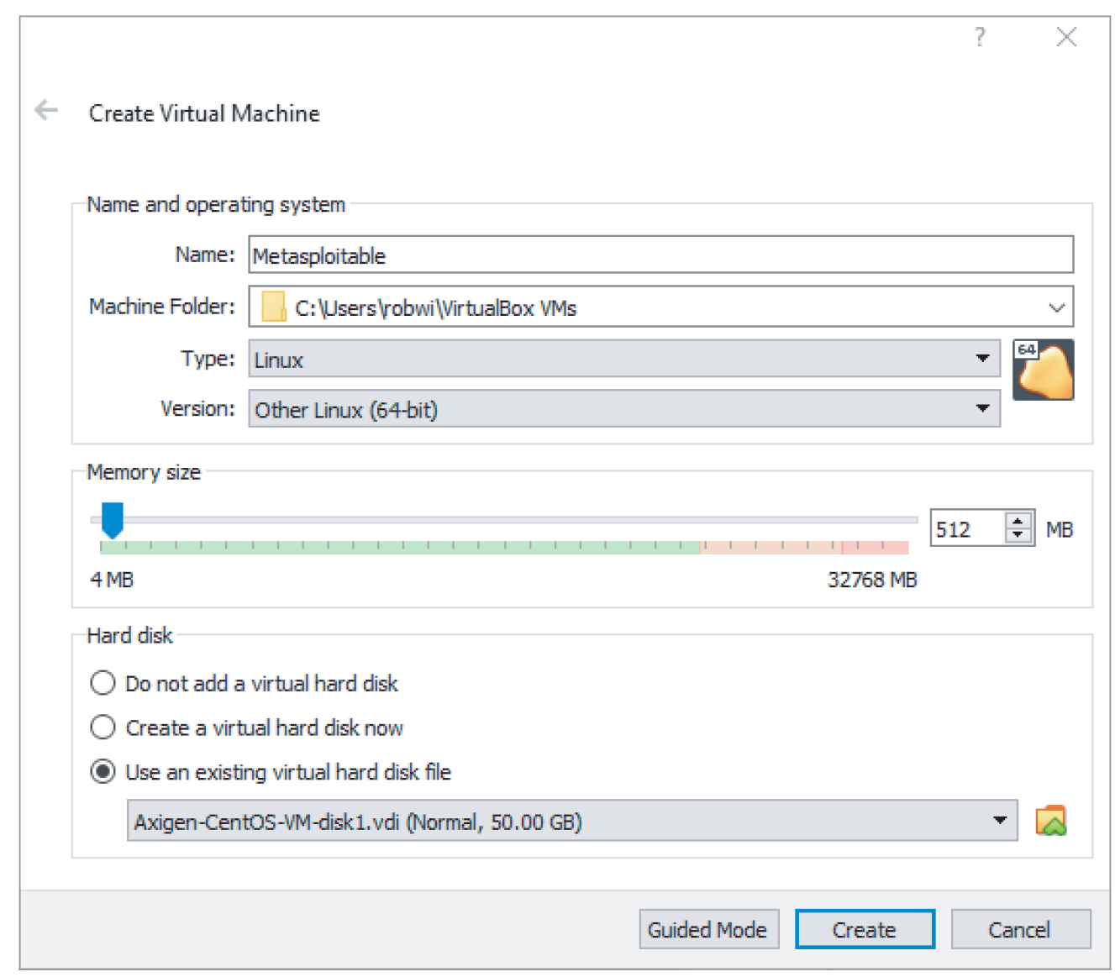
Installing and Configuring Metasploitable2 (5 of 11)
Oracle VirtualBox
Figure 14-7 Create Virtual Machine dialog box

Slide 18
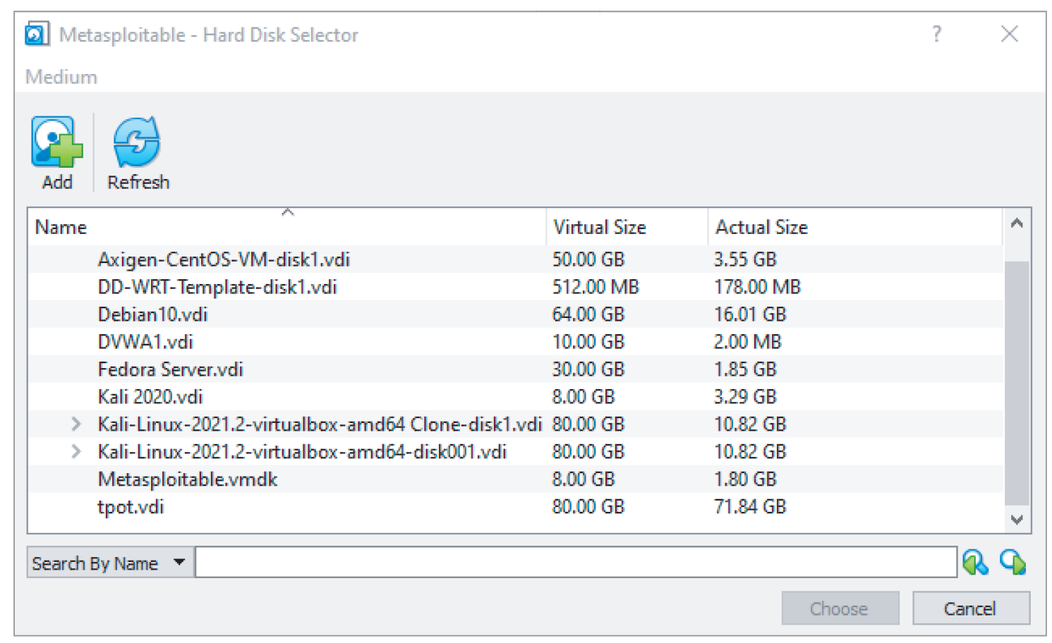
Installing and Configuring Metasploitable2 (6 of 11)
Oracle VirtualBox
Figure 14-8 Hard Disk Selector window

Slide 19
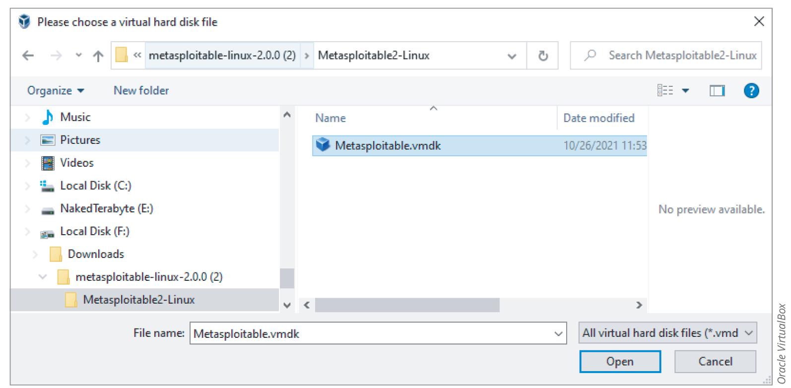
Installing and Configuring Metasploitable2 (7 of 11)
Click the Add button and navigate to the extracted folder to find the Metasploitable.vmdk file
  Add this file to the list of hard disks to use it with the Metasploitable2 VM

Slide 20
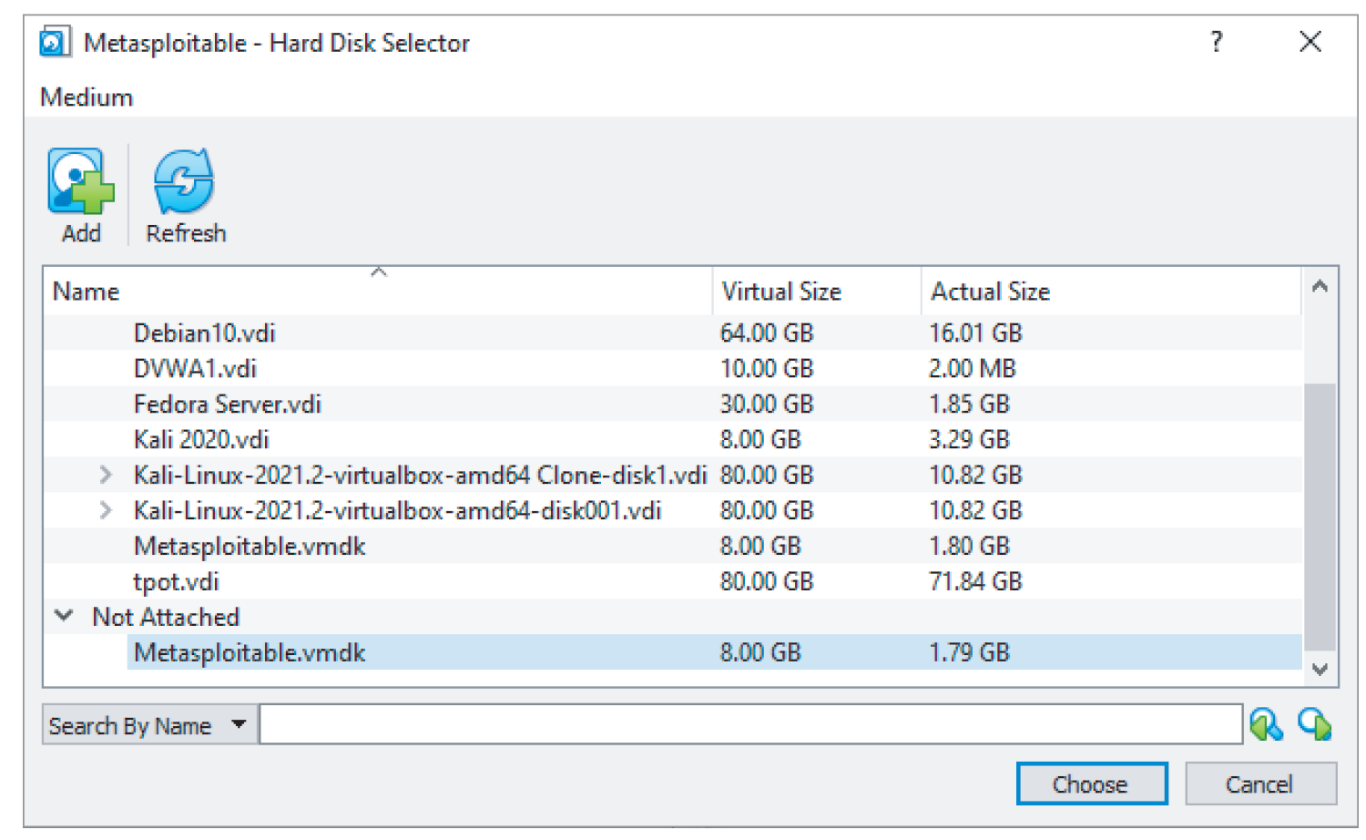
Installing and Configuring Metasploitable2 (8 of 11)
Oracle VirtualBox
Figure 14-10 Choose the Metasploitable.vmdk file

Slide 21
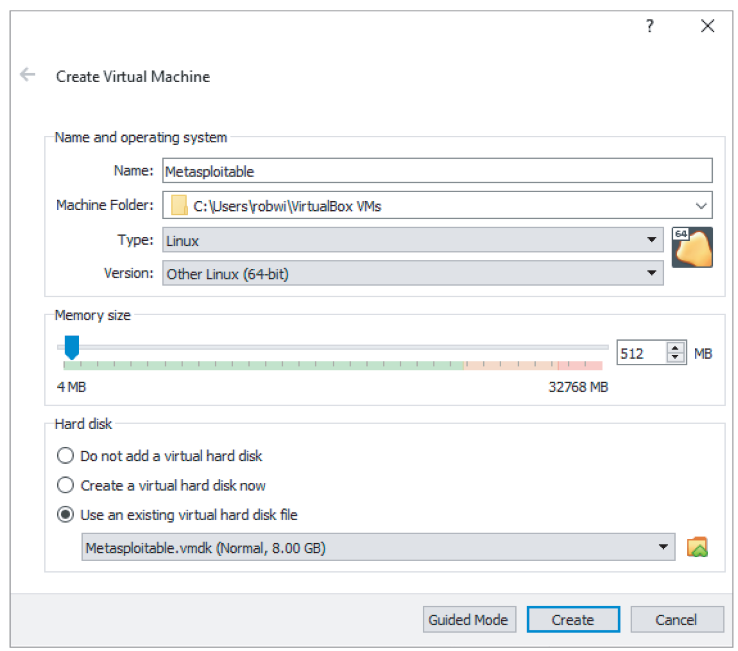
Installing and Configuring Metasploitable2 (9 of 11)
Oracle VirtualBox
Figure 14-11 Creating the Metasploitable VM

Slide 22
Installing and Configuring Metasploitable2 (10 of 11)
In VirtualBox, right-click the Metasploitable VM in the right pane
  Click Start on the shortcut menu
  Then click Normal Start to start the Metasploitable VM
Sign in to the Metasploitable VM using msfadmin as the username and msfadmin as the password
Type ifconfig and press Enter
Note the IP address of the eth0 interface

Slide 23
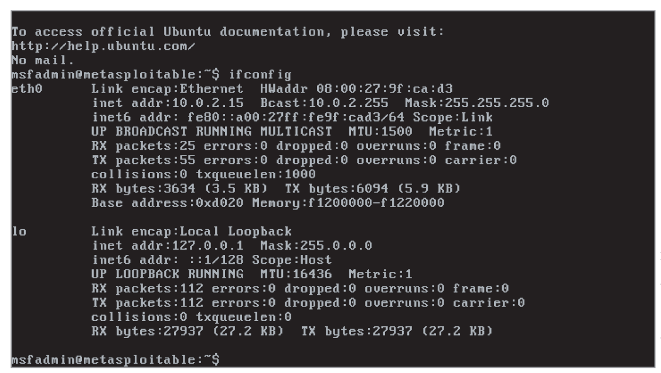
Installing and Configuring Metasploitable2 (11 of 11)
Rapid7 Metasploitable
Figure 14-13 Using ifconfig to determine the Metasploitable2 VM IP address

Slide 24
Knowledge Check Activity 14-1
VirtualBox cannot run VMs unless the Hyper-V service is disabled. True or false?
Notes:
Instructions:
Use the Knowledge Check questions to periodically pose a question to students during class to gauge how well they can recall the material that was presented.

Slide 25
Knowledge Check Activity 14-1: Answer
VirtualBox cannot run VMs unless the Hyper-V service is disabled. True or false?
Answer: True.
If Microsoft Hyper-V virtualization is running on your computer, you must disable the Hyper-V service in order for VirtualBox to work.

Slide 26
Polling Activity 14-1
Which type of VirtualBox network adapter allows connectivity between VMs and the host but excludes other devices on the local network?
Bridged adapter
Host-only adapter
Network Address Translation (N A T)
Internal network
Notes:
Instructions:
1. Use this activity to solicit student opinions about concepts in the module or to play a game.
2. Go to kahoot.com, or the platform of your preference, and log in or sign up.
3. Create the challenge.
4. Teacher tip: Turn off the timer to prioritize accuracy, or turn on the nickname generator to avoid inappropriate nicknames.
5. Invite players by sharing the link or PIN.
6. This can be done synchronously during class or asynchronously for review or homework.

Slide 27
Polling Activity 14-1: Answer
Which type of VirtualBox network adapter allows connectivity between VMs and the host but excludes other devices on the local network?
Answer: b. Host-only adapter
A host-only adapter network allows connectivity between the new virtual machines (VMs) and the host. All other devices that you may be connected to on any real network are isolated when you use the host-only adapter network.

Slide 28
Creating a Penetration Testing Report (1 of 7)
A penetration testing document report should contain the following information:
  Details of your findings
  Targets you were penetration testing
  Tests and tools you used
  Summaries to provide the reader with overview information
  Recommendations and conclusions that suggest how to mitigate any security issues found
You are going to use a specific format to create the report in this module
  But other formats are available

Slide 29
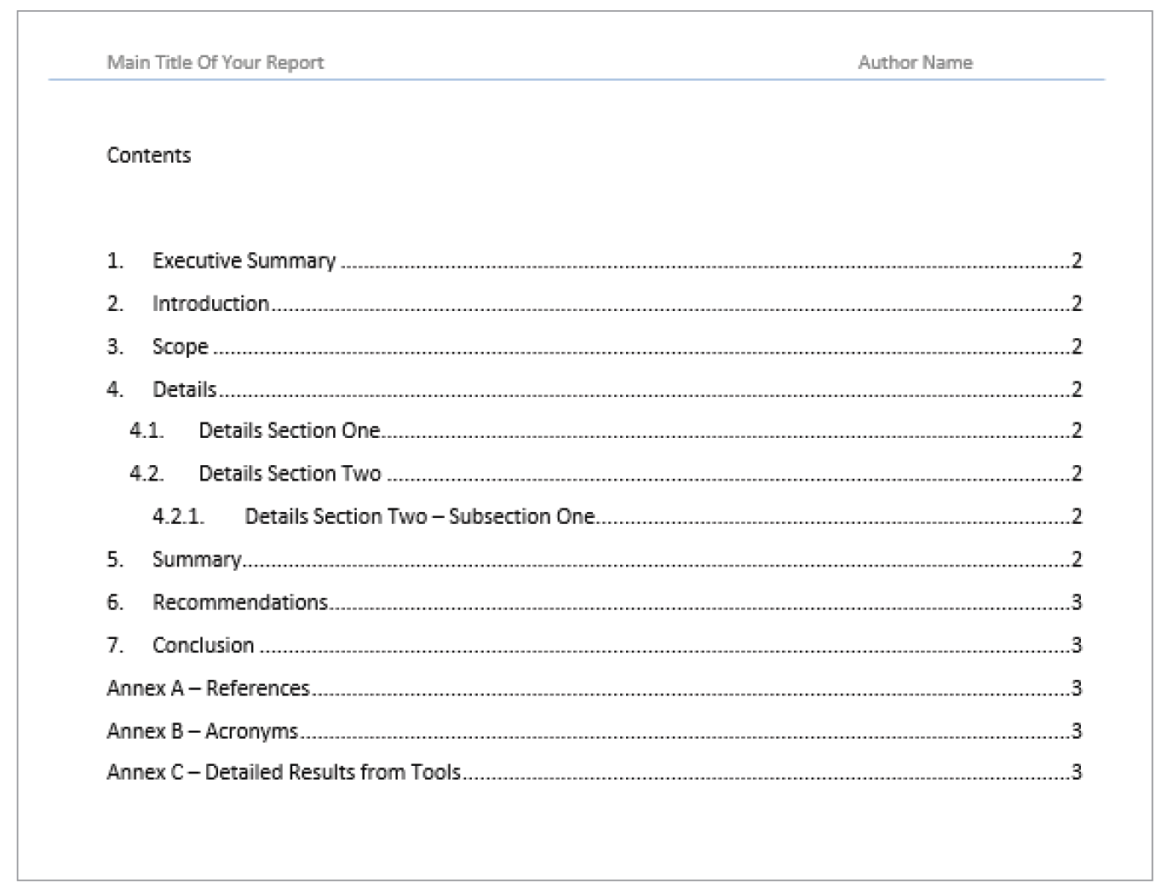
Creating a Penetration Testing Report (2 of 7)
Standard technical report format is used

Slide 30
Creating a Penetration Testing Report (3 of 7)
The report can be created using Microsoft Word
Include the following sections and content in your report:
  Executive summary
    Summarize the scope of your testing and your findings, recommendations, and conclusions in a few short paragraphs
  Introduction
    Introduce the topic of the report and its purpose
    Discuss the goal of the penetration testing and how you will achieve and demonstrate the goal

Slide 31
Creating a Penetration Testing Report (4 of 7)
Scope
  Outline the specific set of information that you are targeting in the scope section
  For penetration testing, scope details include:
    The targets you are testing
    The types of tests you are doing
Details
  The section where you communicate all your work, discoveries, steps, and results
  The convention is to organize and divide the details as follows:
    4.1. Details Section One
    4.2. Details Section Two
    4.2.1. Details Section Two – Subsection One

Slide 32
Creating a Penetration Testing Report (5 of 7)
Summary
  Summarize your findings and craft an overall message from the information contained in the details section
    Note that this is not your conclusion
Recommendations
  Based on your original goal, details, findings, and summary, make an organized set of recommendations
  Should include steps to:
    Solve problems
    Simplify procedures
    Improve security
  In a penetrating testing report, the recommendations should outline steps to fix any vulnerabilities found during the testing

Slide 33
Creating a Penetration Testing Report (6 of 7)
Conclusion
  Write one or two paragraphs that tie together what your goal, details, discoveries, and recommendations have revealed
Annex A – References
  Include references to external information sources that you have mentioned in your document, such as websites and books
Annex B – Acronyms
  Include a list of acronyms and definitions in a separate section if the report uses many of them

Slide 34
Creating a Penetration Testing Report (7 of 7)
Annex C – Detailed Results from Tools
  If you are using tools that gather a lot of data as the basis of your report, you can include that data in a separate section for completeness
  Allows the reader to check your evidence
Before starting the penetration testing lab work, create the framework of your penetration report document using the structure outlined in this section

Slide 35
Using the nmap Command
nmap
  Useful command-line tool for discovering computing devices and their open ports on a network
  nmap information can be used to target systems with other scanning tools such as Nessus

Slide 36
Using the netcat Command (nc) and HTTP Methods
Useful command-line tools for extracting information from web servers
netcat (nc) command
  Information obtained from the command can reveal vulnerabilities
    Can be used to target systems with other scanning tools such as Nessus
  Netcat reveals information such as the web server software the target is running
    May reveal vulnerabilities

Slide 37
Using the wget Command
wget command
  Useful command-line tool for extracting information from web servers
  Allows you to download files from a web server
    You can examine those files to find vulnerabilities to target with other pen-testing tools

Slide 38
Using the enum4linux Command
Useful command-line tool for enumerating Linux systems
Information obtained from this command can be used to target systems with other pen-testing tools such as Nessus

Slide 39
Using Nessus (1 of 2)
Using Nessus Essentials to scan all the virtual machines (VMs) in your pen-testing lab environment
  Step 1
    Use Nessus to perform a Host Discovery scan on your host-only adapter network
      See if it detects all the VMs in your pen-test lab environment
    Target the host-only adapter network (perhaps 192.168.56.0/24) and not your real network
  Step 2
    Scan each target VM individually for vulnerabilities
    Perform a Basic Network scan and possibly a Web Application Test scan of each VM
      Will reveal sufficient information for your report

Slide 40
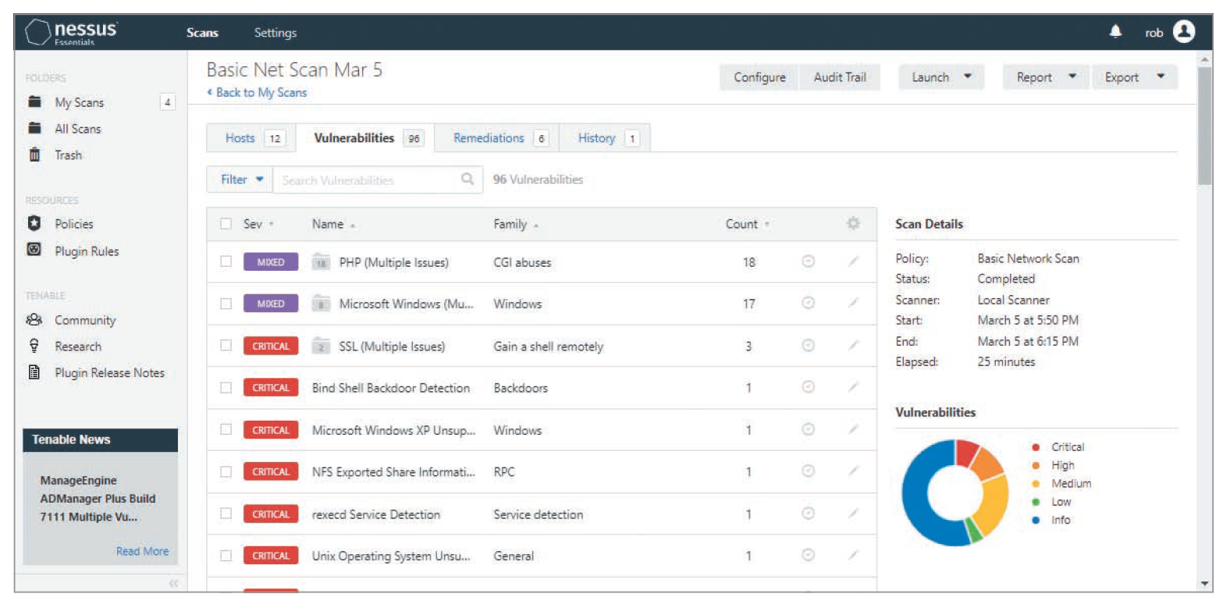
Using Nessus (2 of 2)
Tenable Nessus
Figure 14-15 Vulnerability information from a Nessus scan

Slide 41
Researching Vulnerabilities at the CVE Website
The CVE website is useful for researching vulnerabilities
Visit the Search CVE List page to search for vulnerabilities by specific CVE number or with keywords
Use the NIST national vulnerability database search feature at its website to conduct vulnerability research
  Nessus vulnerability report information often contains links to CVE information found in the NIST national vulnerability database

Slide 42
Completing the Report
Once the penetration tests are performed, the report needs to be finalized
  Gather all the information you have collected
  Add the key findings to the details section of the report
  Follow the guidelines given in the “Creating a Penetration Testing Report” section of the module

Slide 43
Knowledge Check Activity 14-2
Which of the following tools can be used to discover open ports? (Choose two correct answers.)
nc
nmap
Nessus
Wget
Notes:
Instructions:
Use the Knowledge Check questions to periodically pose a question to students during class to gauge how well they can recall the material that was presented.

Slide 44
Knowledge Check Activity 14-2: Answer
Which of the following tools can be used to discover open ports?
Answer: b and c. nmap and Nessus
nmap and Nessus are two tools used to discover open ports. nmap is a useful command-line tool for discovering computing devices and their open ports on a network. You can use the nmap information to target systems with other scanning tools such as Nessus.

Slide 45
Discussion Activity 14-1
Discuss the main points that need to be included in the details section when you are creating a penetration testing report. Compare your answers with that of your classmates.
Notes:
Instructions:
Use the Discussion activity to encourage group conversation about a related topic of interest.

Slide 46
Discussion Activity 14-1: Answer
Discuss the main points that need to be included in the details section when you are creating a penetration testing report.
Answer: 4.1 Details Section One, 4.2. Details Section Two, and 4.2.1. Details Section Two – Subsection One
Explanation: Each details section should summarize results from the tool you used to gather the information. If a single activity impacts many systems, such as an Nmap scan of an entire network, you can capture all those details in one details section and then repeat the results for a specific target in the subsection for that target. Many tools provide summary reports and tables of findings. Extract this information and include it in the appropriate details section. Complete listings of all the information found could later be included in an addendum or provided as a supporting file on storage media.

Slide 47
Hands-On Ethically Hacking Revisited (1 of 2)
The activities in this module use only a few of the tools and methods previously discussed in this course
Experiment with some of the other tools and methodologies since you already have a penetration testing lab environment
  See what they reveal about your lab targets
You can go back to previous modules
  Try the tools and methods described in those modules on your penetration testing lab environment

Slide 48
Hands-On Ethically Hacking Revisited (2 of 2)
You have reached the end of this course
  Continue to research the topic of hands-on ethical hacking
  Gather more intelligence on the matter from different viewpoints
  Search the Internet for various examples of hacking techniques discussed in this course
    Proceed with caution and avoid downloading any unknown tools or executables

Slide 49
Polling Activity 14-2
What color hat should you wear when exercising your hands-on ethical hacking abilities?
black
white
gray
multicolored
Notes:
Instructions:
1. Use this activity to solicit student opinions about concepts in the module or to play a game.
2. Go to kahoot.com, or the platform of your preference, and log in or sign up.
3. Create the challenge.
4. Teacher tip: Turn off the timer to prioritize accuracy, or turn on the nickname generator to avoid inappropriate nicknames.
5. Invite players by sharing the link or PIN.
6. This can be done synchronously during class or asynchronously for review or homework.

Slide 50
Polling Activity 14-2: Answer
What color hat should you wear when exercising your hands-on ethical hacking abilities?
Answer: b. white
You should always have your white hat on when exercising your newly acquired hands-on ethical hacking abilities.

Slide 51
Self-Assessment
Recall the items appearing in the table of contents in a penetration testing report.
List the number of virtual machines (VMs) running inside of Oracle VirtualBox.
Notes:
Instructions:
Use the Self-Assessment question to encourage students to evaluate their progress or goals in the course as well as to determine how they might apply their learning or grow as an individual.

Slide 52
Summary
Now that the lesson has ended, you should be able to:
  Set up a penetration testing lab of virtual machines for use in penetration testing activities and practice
  Perform penetration testing and vulnerability analysis using tools previously discussed in this course
  Create a penetration testing report document to capture and communicate information regarding the vulnerabilities discovered during your penetration testing

